Slide 1



Predict Customer Personality to boost marketing campaign by using Machine Learning
Created by:
Lana Fuadi
lanafuadi@gmail.com
linkedin.com/lanafuadi
“I am a results-driven data scientist with a passion for leveraging data to drive business success. Through rigorous training at Rakamin Bootcamp, I have honed my skills in Python, ML, SQL, and Business Intelligence. I am committed to continuous learning and have completed additional certifications and course to further enhance my expertise. With strong collaboration, critical thinking, and problem solving skills, I am confident in my ability to help your company make data-driven decisions that propel your business to new heights.”

Slide 2
Overview
“Sebuah perusahaan dapat berkembang dengan pesat saat mengetahui perilaku customer personality nya, sehingga dapat memberikan layanan serta manfaat lebih baik kepada customers yang berpotensi menjadi loyal customers. Dengan mengolah data historical marketing campaign guna menaikkan performa dan menyasar customers yang tepat agar dapat bertransaksi di platform perusahaan, dari insight data tersebut fokus kita adalah membuat sebuah model prediksi kluster sehingga memudahkan perusahaan dalam membuat keputusan ”

Slide 3
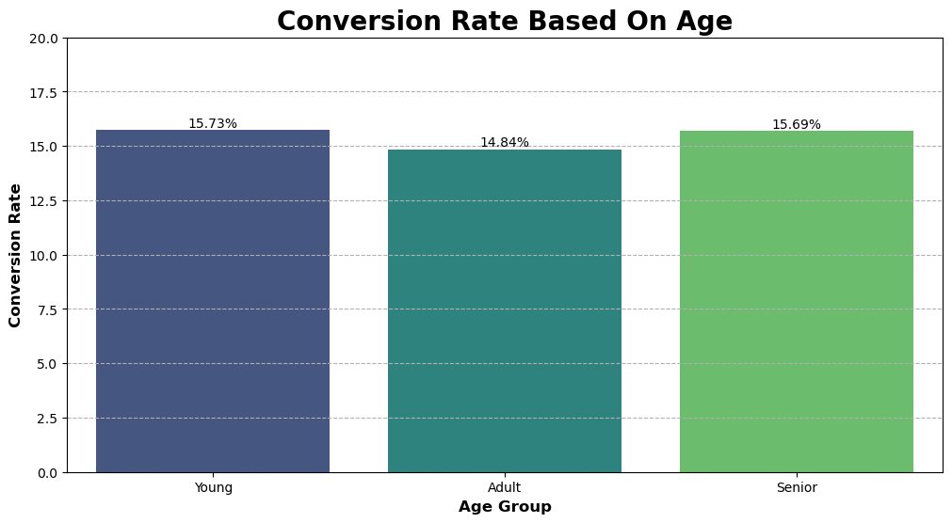
Based on the analysis, all group have relative low conversion rates. it indicates that the existing strategies are not that impactful. this is either because of misaligned marketing or bad website experience. to solve it, we should: 1. improve UI UX design and try to implementing A/B testing to ensure a positive website experience.
2. retargeting strategies to ensure that that is align with customer preference.
3. young is a potential customer, try to add gamification purchase.

Slide 4
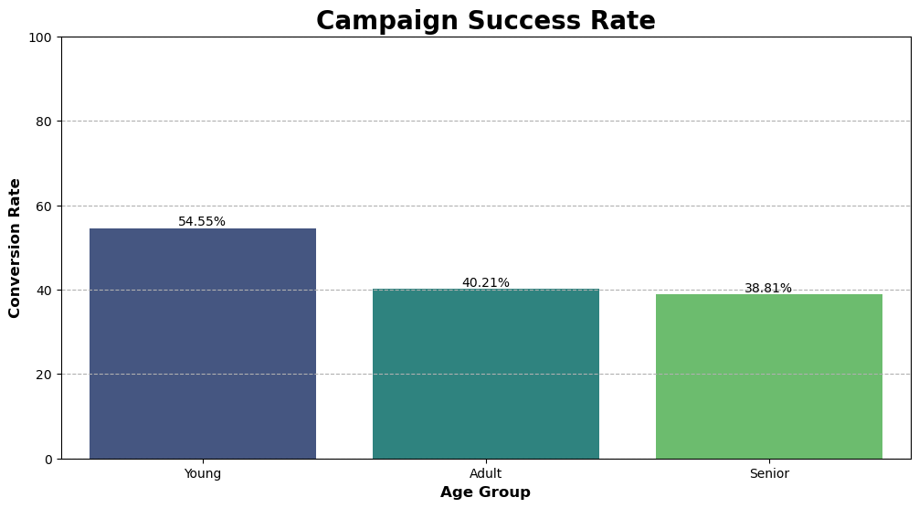
Young group are more likely to make a purchase when receiving a campaign. To maximize campaign success, it is crucial to focus on targeting and tailoring marketing efforts towards young individuals. This could involve creating appealing and engaging campaigns that resonate with their preferences and interests. Both Adult and Senior group has similar rates, it is important to evaluate the existing strategies and identify potential improvement.
For more detail, access jupyter notebook here

